Slide 1
Graph

Slide 2
Graphs
Used to solve complex routing problems
A graph G(V,E) is a collection of vertices (or nodes) and a collection of edges that connect pairs of vertices.
A graph may be undirected, meaning that there is no distinction between the two vertices associated with each edge, or its edges may be directed from one vertex to another

Slide 3
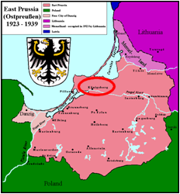
Graphs
Historical Background
In 1736, Euler solved the problem known as the Seven Bridges of Königsberg. The city of Königsberg, Prussia was set on the Pregel River, and included two large islands which were connected to each other and the mainland by seven bridges.
The problem is to decide whether it is possible to follow a path that crosses each bridge exactly once and returns to the starting point.
It is not: there is no Eulerian circuit. This solution is considered to be the first theorem of graph theory, specifically of planar graph theory.
Taken from Wikipedia on 9-Aug-2009

Slide 4
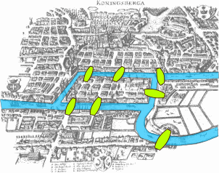
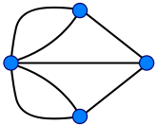
Graphs
The Seven Bridges of Konigsberg
Euler observed that a necessary condition for the existence of Eulerian circuits is that all vertices in the graph have an even degree, and that for an Eulerian path either all, or all but two (i.e., the two endpoint) vertices have an even degree
⇒ this means the Königsberg graph is not Eulerian.

Slide 5
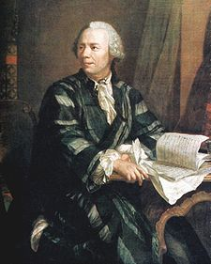
Graphs
Leonhard Paul Euler (15 April 1707 – 18 September 1783)
Swiss mathematician, made important discoveries in fields as diverse as calculus and graph theory.
He introduced much of the modern mathematical terminology and notation. Renowned for his work in mechanics, fluid dynamics, optics, and astronomy.
Euler is considered to be the preeminent mathematician of the 18th century and one of the greatest of all time.
Taken from Wikipedia on 9-Aug-2009

Slide 6
Terminology
Graph
A collection of nodes and line segments
Vertex (plural:vertices)
A node in a graph
Edge
A line which connects two vertices

Slide 7
Terminology
Directed graph (or digraph)
Each edge has a direction
Arc
The edge in a directed graph

Slide 8
Directed Graph
A
vertex
arc
B
E
F
C
D

Slide 9
Terminology
Undirected graph
There is no direction on any graph
The flow can go either direction

Slide 10
Undirected Graph
A
B
edge
E
F
C
D

Slide 11
Terminology
Adjacent Vertices (neighbors)
Two vertices are said to be adjacent if there exists an edge which directly connects them
Path
A collection of edges connecting certain nodes of the graph

Slide 12
Path
A
B
E
F
C
D

Slide 13
Terminology
Cycle
A path consisting of at least three vertices that starts and ends with the same vertex
Must follow the proper direction in a digraph
Loop
A special case of a cycle in which a single arc begins and ends with the same vertex

Slide 14
Cycles and Loops
A
Loop
B
E
F
Cycle
C
D

Slide 15
Terminology
Connectness
Two vertices are said to be connected if there is a path between them
A Directed Graph is strongly connected if there is a path from every vertex to every other vertex in the digraph
A Directed Graph is weakly connected when there are at least two vertices that are not connected
A Graph is disjoint if it is not connected

Slide 16
Connected Graphs
A
B
E
G
F
C
D
H
I
Strongly Connected

Slide 17
Connected Graphs
A
B
E
G
F
C
D
H
I
Weakly Connected

Slide 18
Connected Graphs
A
B
E
G
F
C
D
H
I
Disjoint

Slide 19
Terminology
Degree
The degree of a vertex is the number of edges incident to it
The outdegree of a vertex in a digraph is the number of arcs leaving the vertex
The indegree of a vertex in a digraph is the number of arcs entering the vertex

Slide 20
Degree
A
B
E
G
F
C
D
H
I
The degree of vertex B is three, of vertex E is 4. The indegree of vertex B is one, and the outdegree is two.

Slide 21
Graph Storage Structures
We need two storage structures to represent a graph
The first set holds the vertices
The second holds the edges
Use arrays and linked lists
Disadvantage: the number of vertices must be known in advance

Slide 22
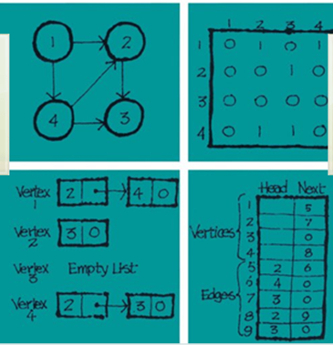
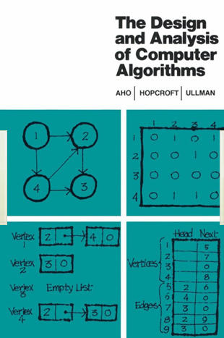
Graph Storage Structures

Slide 23
Adjacency Matrix
The adjacency matrix uses a vector (one dimensional array) for the vertices and a matrix (two dimensional array for the edges
If two vertices are adjacent (there is an edge between them) the matrix insect has a value of 1, otherwise, it is zero.

Slide 24
Adjacency Matrix
A B C D E F
A
A B C D E F
A
0 1 0 0 0 0
B
1 0 1 0 1 0
B
E
C
0 1 0 1 1 0
D
0 0 1 0 1 0
F
E
0 1 1 1 0 1
0 0 0 0 1 0
C
D
F
Vertex Vector
Adjacency Matrix
Adjacency matrix for non-directed graph

Slide 25
Adjacency Matrix
A B C D E F
A
0 1 0 0 0 0
A B C D E F
A
B
0 0 1 0 1 0
B
E
C
0 0 0 1 1 0
D
0 0 0 0 0 0
F
E
0 0 0 1 0 1
0 0 0 0 0 0
C
D
F
Vertex Vector
Adjacency Matrix
This “1” denotes an arc that goes from A to B
Adjacency matrix for directed graph

Slide 26
Adjacency List
A
A
B
B
B
E
A
C
E
F
C
B
D
E
C
D
D
C
E
E
B
C
D
F
F
E

Slide 27
Searching/Traversing a Graph
Question
Given a graph G(V,E) how do I go from node A to node B?
Depth-first-Search (DFS):
As deep as possible, as soon as possible, backtracking otherwise.
Implementation issue: non recursive version uses a stack
Breadth-first-Search (BFS):
Neighbor level visitation.
Implementation: Non recursive version uses a queue

Slide 28
DFS Uses
The principle of the algorithm is quite simple: to go forward (in depth) while there is such possibility, otherwise to backtrack.
Imagine a chess game, where a good player can mentally picture the state of the board 4, 5, 6, even 10 moves away from the current move. This is a depth-first search

Slide 29
Depth First Search
Pick a starting point
If possible, explore an unvisited vertex that is adjacent to the current node, mark it “visited”, then push it on the stack
If there are no more “unvisited” vertices to explore, pop the top of the stack. Consider this node as the next starting point . Repeat step 1.
When the stack is empty, you are done

Slide 30
Depth First Search
procedure dfsSearch ( Vertex v)
begin
mark v “old”;
for each vertex w on L[v] do
if (w is marked “new”) then
begin
add (v, w) to SolutionTree;
dfsSearch (w);
end
end

Slide 31
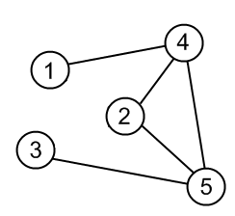
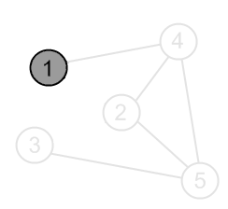
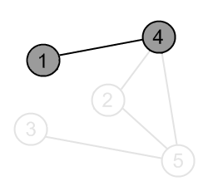
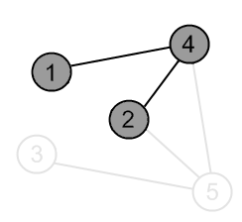
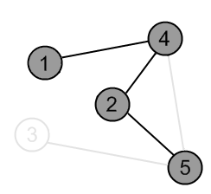
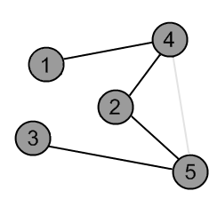
Depth First Search
http://www.algolist.net/Algorithms/Graph_algorithms/Undirected/Depth-first_search

Slide 32
Breadth-first search
A breadth-first search visits nodes in the order of their distance from the start node, where distance is measured as the number of traversed edges.
So, with a breadth-first search, first all nodes one edge away from the start node are visited, then two edges away, and so on until all nodes are visited.
This way, we'll find the path from the start to the goal with the minimum number of traversed edges.
Another way to word it is like this: Visit the neighbor nodes, then the neighbor's neighbor nodes, and so on until the goal node was found.

Slide 33
BFS Rules
Visit the next unvisited vertex that is adjacent to the current vertex. Mark it as “visited”, insert it into the queue.
If there are no more unvisited vertices, remove a vertex from the queue and make it the current vertex
If there are no more vertices in the queue, the process is done

Slide 34
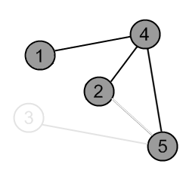
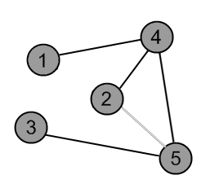
BFS Example
‹#›

